Slide 1


Prevention Peer Network
August 20, 2015
Notes:
Start recording

Slide 2
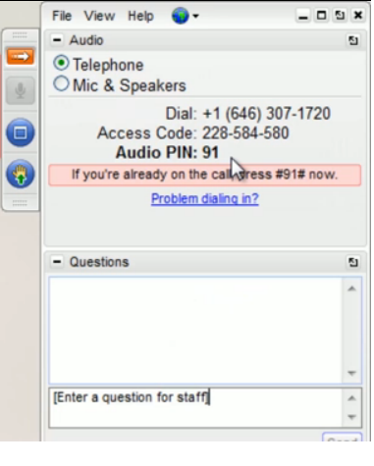

Control Panel
Expand Audio for call in information
Expand/minimize the control panel
Raise your hand to be unmuted
Please note, this webinar is being recorded.

Slide 3
Agenda
Opening Circle
New website and searchable resource library!
Training: Training Youth to Create and Produce Public Service Announcements
Discussion
  Shared expertise, emerging issues, challenges, triumphs
Notes:
These webinars are open to anyone.

Slide 4

Opening Circle
Please type in your name, agency and location

Slide 5

New website and resource library
www.cpedv.org
Notes:
Go to website, show where prevention under CB is. No more PPN page. Resources – searchable library. Webinars can found by searching by title or by searching Prevention peer network. Test one (check before and make sure they are up and connected to each other)

Slide 6
Creating PSAs with Youth
Presented by:
Ashley Solis
Prevention Coordinator

Slide 7
About House of Ruth
1977: House of Ruth began as a volunteer-run domestic violence hotline
Today services are divided into the following programs:
  Hotline
  Residential Programs: Emergency and Transitional Shelter
  Children’s Programs
  Counseling & CHAT
  Classes
  Temporary Restraining Orders
  Case Management
  Prevention and Community Education Program
  Volunteer Program

Slide 8
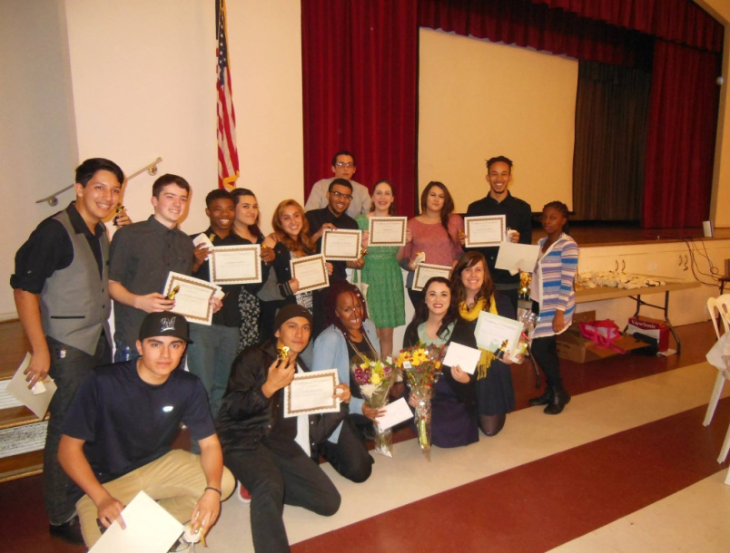
House of Ruth’s Mission
  To advocate for and assist women and children victimized by domestic violence and children exposed to violence in transforming their lives by providing culturally competent shelter, programs, opportunities, and education; and To contribute to social change through intervention, education, prevention programs and community awareness.
Students from San Antonio High School after their PSA film screening. December 2014

Slide 9
Prevention and Community Education Program
Goal of our program is to contribute to social change through primary prevention activities and education.
My Role as Prevention Coordinator
  Member of House of Ruth’s Leadership Team
  Provide mentorship to Prevention Educator
  Facilitate and coordinate community presentations
  Curriculum building
  Facilitate 40-Hour Domestic Violence volunteer training
  Supervise volunteers
For fiscal year 2013-14, House of Ruth Prevention staff and volunteers presented to
  191 schools
  56 social service agencies and organizations
  54 community fairs

Slide 10
Creating Public Service Announcements (PSA)
PSAs can be used as:
  Primary prevention
    Activities that take place before violence occurs to prevent initial perpetration or victimization
  An evaluation tool
    In addition to pre and post surveys

Slide 11
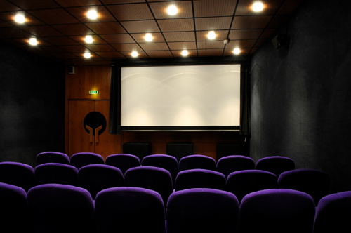
Planning and Implementation
Choose a school and specific group of students (clubs, class, groups)
Choosing topics for workshops
Teacher engagement is vital
Mentor for each group is ideal
Is there a space for a film screening
  Technology
  Food/drink
  Awards
Marketing the PSA Screening
Engaging students in Ceremony
Panel of students for Q&A

Slide 12
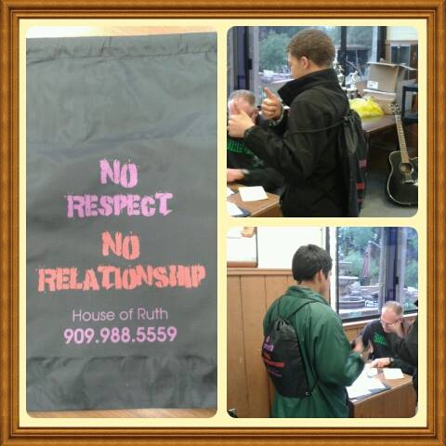
Creating PSA’s
8-10 Workshops and hands-on classes with two specific goals.
  Goal #1: To educate students about social issues such as dating violence, bullying and depression in a safe and supportive environment.
  Goal #2: To train students how to be agents of change on campus, in the community, and worldwide using video as a tool.
Topics may include:
  Gender roles
  Media Literacy
  Self-esteem
  Body Image
  Bullying
  Depression and suicide
  Teen Dating violence
  Healthy friendships and relationships
  Boundaries and consent
  Anger
  How to help a friend

Slide 13
Sample Schedule
# | Date: | Topic:
1 | Wed Sept. 17 | Getting to Know You: Introductions, Icebreakers and Team Building Activities
2 | Wed. Sept. 24 | Gender Roles: Life in a Box Exercise “Gender Box PSA” “Impossible Dream”
3 | Wed. Oct. 1 | Media Literacy “Killing Us Softly 4” “Mickey Mouse Monopoly” “Tough Guise” Clip”
4 | Wed. Oct 8 | Self-Esteem and Body Image
5 | Wed Oct 15 | Teen Dating Violence
6 | Wed Oct 29 | Anger: “How We Feel, How We Deal”
7 | Wed Nov 5 | Boundaries and Consent
8 | Wed Nov 12 | Recognizing and Seeking Healthy Friendships and Relationships
9 | Wed Nov 19 | Intro to Video (Lighting, sound, and filming)
10 | Wed Dec 3 | Group Formation and Storyboarding
11 | Dec 8-18 dates/times TBD | Film and Edit PSA(s)

Slide 14

Session 1: Intro to Video
After the 8-12 workshops, complete program with film techniques and application.
  Facilitate discussion of why youth created media is important
  You don’t have to have to be an expert to create PSAs
  Show examples of youth created PSAs Gender Box PSA
    Talk about lighting, filming, editing, was the message clear, etc.
  Lighting, Sound, and Filming
  Brainstorm ideas based on topics
  Brainstorm Page for individual
    PSA Brainstorm #1

Slide 15
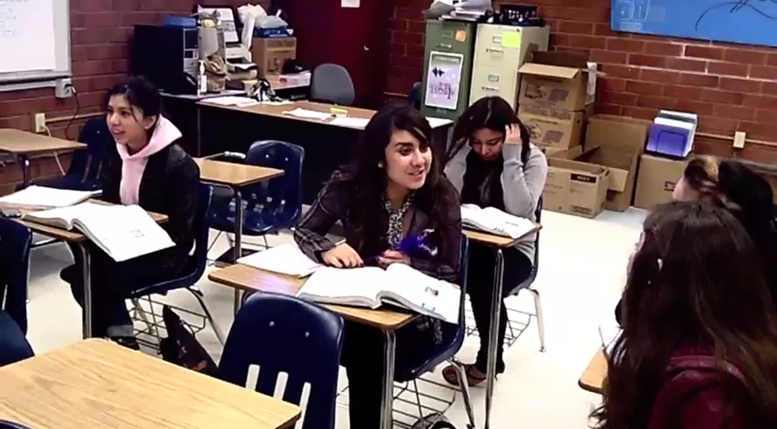
Why is youth created media important as a primary prevention tool?
We All Rise Together created by Teenage Dream(makers) project

Slide 16
Why is youth created media important as a primary prevention tool?
Peer to peer education is beneficial because the can relate to one another
Youth has a pulse on what is occurring in their peers groups and communities
Youth can model positive and healthy behaviors which is more likely to affect social norms
Opportunity to build skills and confidence
Creates sustained and meaningful relationships between mentor and mentee
Empowering youth to take the lead in planning and executing projects
Structuring a process in which youth actively participate in decision making

Slide 17
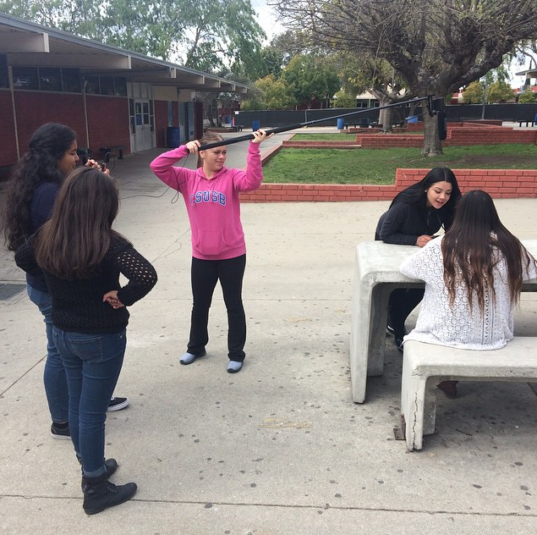
Lighting, Sound, and Filming
Lighting
  Natural Light vs. Indoor Lighting
  Natural Lighting
    http://bit.ly/1KgLwCf
Sound
  Boom microphone
    http://bit.ly/1LyqNLY
  Background Noise
Filming
  Rule of Thirds
    http://bit.ly/1CSwsej
  How to use the video camera
    http://bit.ly/1JbYzGr

Slide 18

PSA Brainstorm #1
I have used a video camera before: Yes/No
I have edited video before: Yes/No
1. Who is your audience? Who do you want to influence with your message? (Boys, girls, parents, teens, children, etc.)
2. What are the topics that have been most interesting to you in the past 10 weeks?
3. What are the topics that have impacted your life the most in the past 10 weeks?
4. If you could share something you learned in the past 10 weeks with your community, what would it be?
5. List any topics you would be interested in making a PSA (Public Service Announcement) about other than those listed in questions 2-4.
6. What would you imagine your PSA looking like? For example: Where does it take place? Is it going to be acted out? Is it going to be someone’s true story? How many people would it take to complete the project?
7. Would you be willing to be on camera? Would you be OK with the video being on YouTube?

Slide 19
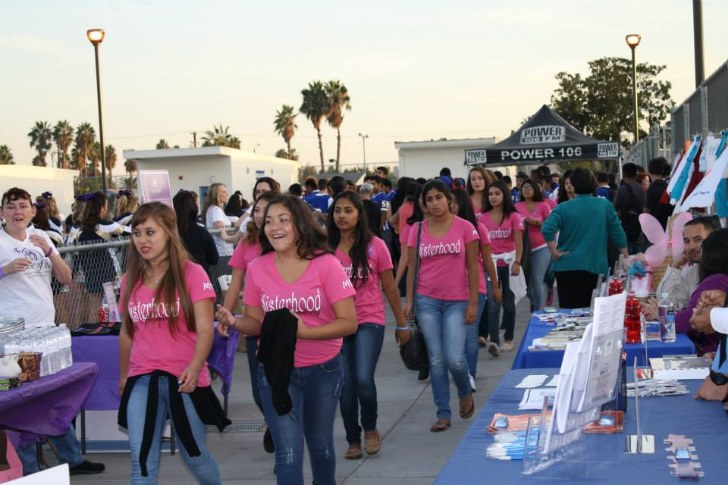
Session 2: Group Formation and Storyboarding
Group Formation
  Based on 1st brainstorm
  Groups complete PSA brainstorm #2
Storyboarding
Share ideas with entire group
  Feedback from mentor/students

Slide 20
PSA Brainstorm #2
1.Who is your audience? Who do you want to influence with your message?
2. What is the message of your video?
3. How are you going to make your message clear?
4. Will there be acting in the video? If yes, who will be acting? If no, what method will you be using and do you have the resources?
5. What props, location or scenery would you need?
6. What techniques or ideas from the videos you saw today can you use for your video?

Slide 21
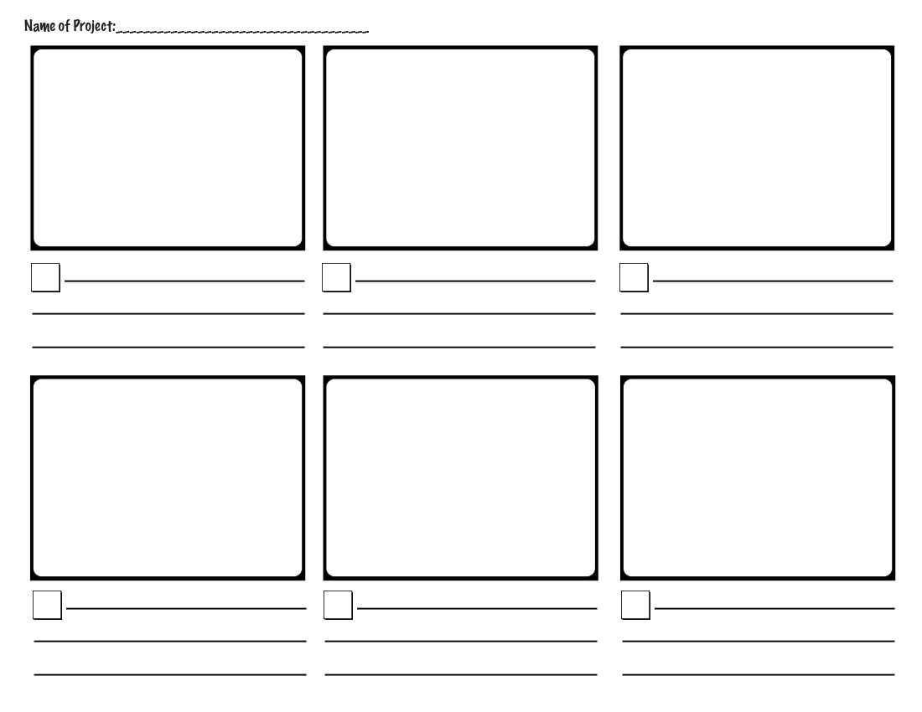
Story Boarding
http://bit.ly/1LyrFA8

Slide 22

Film and Edit
You don’t need expensive equipment to create a PSA
Try to film over one day
Editing
  Students can edit
  Title
  Credits
  Royalty Free Music
Programs:
  iMovie (Mac)
  Windows Movie Maker (PC)

Slide 23


PSA Film Screening

Slide 24
Challenges and Lessons Learned
Prevention Volunteers are not always available for a long commitment
Students have big ideas. Working with them to be more realistic and concise.
Encouraging students to not sensationalize or show anything graphic (Suicide, TDV)
Clothing and time of day
Reflection in window: http://bit.ly/1fYVOgD at 45 seconds
Background noise: http://bit.ly/1VlKdYU

Slide 25
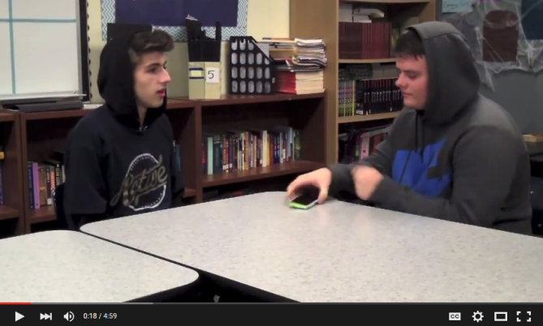
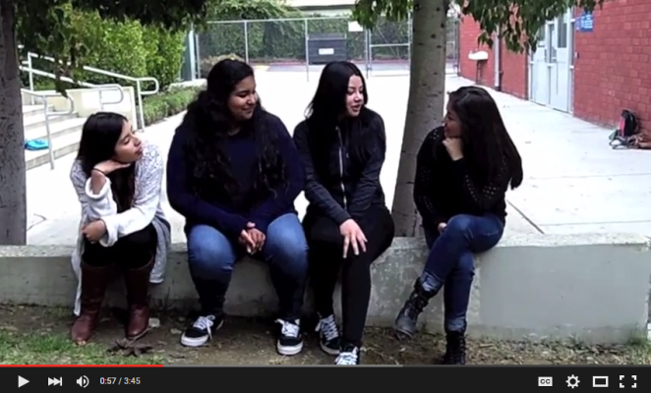
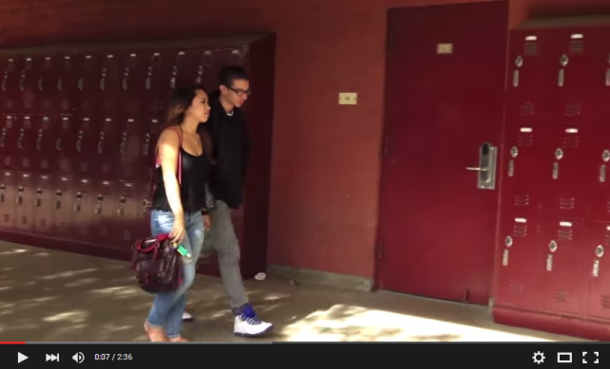
PSAs Created
How to Help a Friend
Lurking (Stalking)
Consent or Nah
Act Like a Lady
Rewinding Kate
Talk about It
Peer Pressure
Teen Dating Violence
Healthy Friendship

Slide 26

Shared expertise and discussion
Other expertise or experiences with PSA’s or multi-media efforts?
Current emerging issues?
Challenges or triumphs?

Slide 27

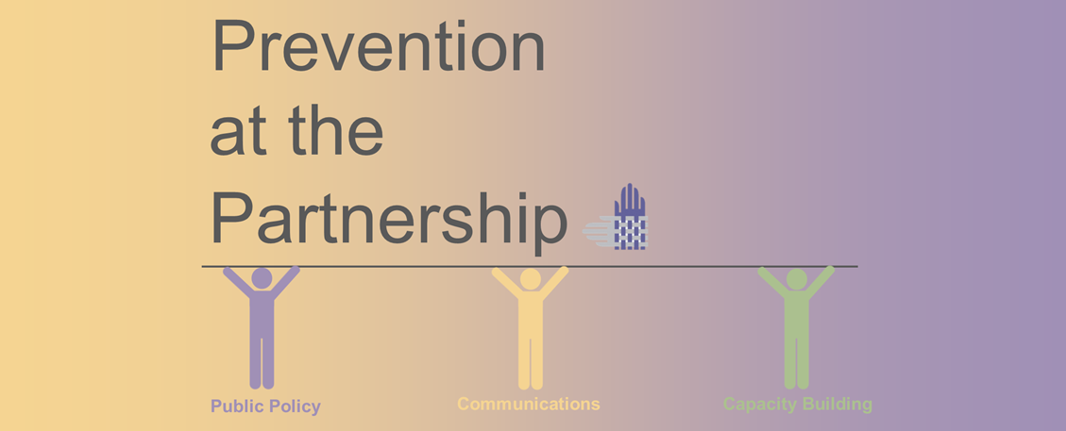
Together we’re stronger.
Emily Martin
emily@cpedv.org
916-444-7163 ext. 110

