Slide 1
Payment Requests

Slide 2
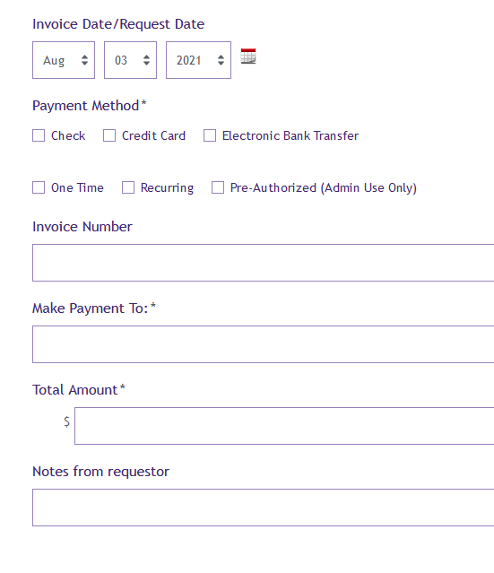
Invoice date: At FY end or grant year end, should be the date of the invoice or the date the service was provided, which ever is earliest.
Recurring: Only for monthly payments of an ongoing service contract that is paid automatically by credit card or bank transfer.
We don’t have the capacity to track when short term contracts need to be paid more than once.
Notes from requestor: this should be anything you need the approver or admin staff to know. Please note who the note is for

Slide 3
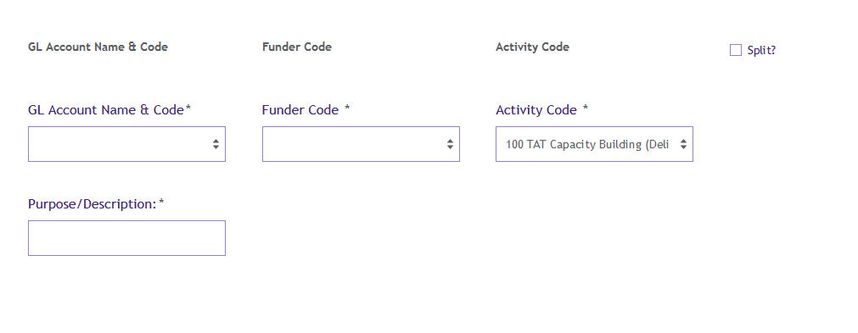
Funder code: 000 is not applicable to anything other than our administrative expenses that are billed to all programs/funders such as Rent, IT maintenance contract, General office supplies, Zoom, etc. Generally these are bills that the admin team receives.
Split- more than one GL, funder code and or activity code
Purpose/Description- keep it brief, 2-5 words. This becomes the memo in quickbooks. Should clearly state the purpose of the payment. “Participation in Advocate media training”, “Facilitate 3 Culturally Responsive Collaborative meetings”, “June IT services”, “Materials for South Region Retreat”.
This is how we can tell at first glance if the coding is correct or if we need to move things around, which items might be eligible to move to another funder.

Slide 4
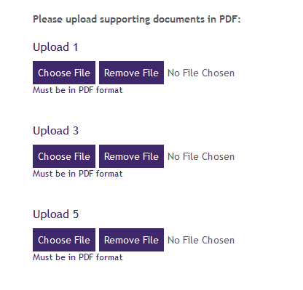
Upload
Invoice
Fully executed contract if used instead of an invoice
NEVER UPLOAD HERE:
W9s
Any document with social security numbers

Slide 5
First round approval, Usually all that is needed based on our procedures. Approver is usually the Program Manager/Director. Can also be Specialist for up to $1,000 and it in the budget.

Slide 6
Prepayments
Accounting and funder guidelines require us to only book expenses that were for goods and services received in the Fiscal year and/or grant year.
This means we can pay this FY for services and goods we expect to receive next FY but we can’t book the expense in our accounting system until the good or service is received
If the payment is for something that has not happened yet use GL 1340: Prepaid expense Other. Note the GL, and the expected date the good/service will be delivered in Notes from the Requestor field. Once the activity is completed we will book the expense correctly
Please do not use the term “Retainer”. This is not allowed by federal funders.
Some examples: Conference Keynote Speakers, facilities fees, subscriptions, trainings and conference registrations

