Slide 1



Domestic Violence Awareness Month
Growing the Seeds of Healing & Justice
Jessica Merrill
Communications Manager
California Partnership to End Domestic Violence
July 18, 2019 | 10:30 a.m. – 12:00 p.m.

Slide 2
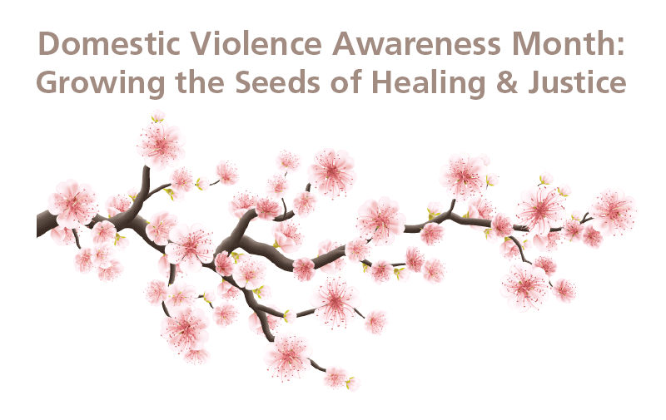

Growing the Seeds of
Healing and Justice
Main Components
Survivor Survey
Quotes blooming from cherry blossom tree infographic

Slide 3

Inspiration
Informed by Partnership staff members
Elevating Root Causes of Domestic violence ➜ Highlighting solutions that change social norms
Passing the Mic to Survivors
Educating policymakers and Californians

Slide 4
Survivor Voices
Survivor Quotes
Accountability:
1. What would you need from the person who caused you harm to feel they've held themselves accountable?
“A sincere acknowledgment that they understand the depth of the harm and injury they did to me and also my family; an acknowledgement that includes an admission of guilt and what, if anything, they have done to heal themselves.”
“To get the treatment they find most effective in their own life to stop abusive behaviors to others. To respect my privacy and space.”

Slide 5
Survivor Voices
Survivor Quotes
Gender Justice:
7. Given that one of the root causes of DV is rigid gender roles, what changes in your community would enhance the feeling of being accepted for who you are? We encourage survivors of all genders to respond, including people who identify as gender fluid, trans, Two Spirit, and nonbinary.
“Male domestic violence survivors need to be acknowledged and validated by their experience of abuse. Community wide domestic violence education and awareness needs to become the norm.”

Slide 6
Survivor Voices
Survivor Quotes
Embracing Sexual Orientation:
8. How can schools, workplaces religious institutions, etc. create welcoming environments for lesbian, gay, bisexual, pansexual, and asexual survivors, and how would this work to prevent abusive tactics?
“Say out loud you are here for us. Say out loud that you welcome us. Say out loud that you need to do more training. Say out loud that you do not tolerate discrimination. Maybe others will be inspired by your bravery.”
“The number one thing is to not assume one’s sexual orientation. Sexual orientation is a spectrum and most of us are not 100% gay or straight. Always speak as an ally; meaning no derogatory jokes, phrases, or words.”

Slide 7
Survivor Voices
Survivor Quotes
Faith-Based Support:
How can faith-based institutions change the social norms that contribute to domestic violence?
“Help change the common gender narrative. Preach that all sexes are allowed to open up and be sensitive. That expressing our emotions in healthy ways, is extremely important to maintain productive relationships. Teach open communication.”

Slide 8
Tools for You
Customizable Infographic for Your Organization or Community
Adaptable Survey (Word document)
Survivor Quote Templates for Social Media
Sample DVAM Resolution

Slide 9
Outreach and
Awareness Building
Reaching Survivors through Support Groups
Collecting responses in your community using adaptable survey (sharing with the Partnership, if possible)
Using our adaptable infographic, create a display with quotes at a local library, city hall, or county building
Pitch a story to a local journalist on survey results and emerging themes
Share survey results with policymakers; invite them to visit your organization during DVAM

Slide 10
Questions

Slide 11
Contact Me
Jessica Merrill
Communications Manager
California Partnership to End Domestic Violence
jessica@cpedv.org
Notes:
Registration link in follow up email.

