Slide 1
New Domestic Violence Laws 2025 January 14, 2025

Slide 2
Land Acknowledgement
We acknowledge that we are on the traditional territory and homelands of California Native Peoples. These Nations include federally recognized tribes and many other non-recognized tribes that are all culturally diverse. We thank these Nations and we keep them in our hearts and thoughts as we are in this space today, this week, and every day.
Notes:
https://native-land.ca/ or (907) 312-5085
Acknowledging the land is an indigenous protocol and the practice establishes a respectful routine and habit of supporting these Nations and prioritizing decolonization.
To recognize the land is an expression of gratitude and appreciation to those whose homelands we reside on and a recognition of the original people who have been living and working on this land since the beginning and continue to do so today.
It’s imperative that we are really intentional about incorporating the behavior into our “Normal”. The REAL work is in-between these larger activities.
This is not just the work of Native Peoples and we invite each and every person to be mindful and acknowledge the land.

Slide 3
Office on Violence Against Women
This webinar was supported by Grant No. 15JOVW-24-GG-00918-STAT, awarded by the Office on Violence Against Women, U.S. Department of Justice. The opinions, findings, conclusions and recommendations expressed in this webinar are those of the author(s) and not necessarily reflect the views of the Department of Justice, Office on Violence Against Women.

Slide 4
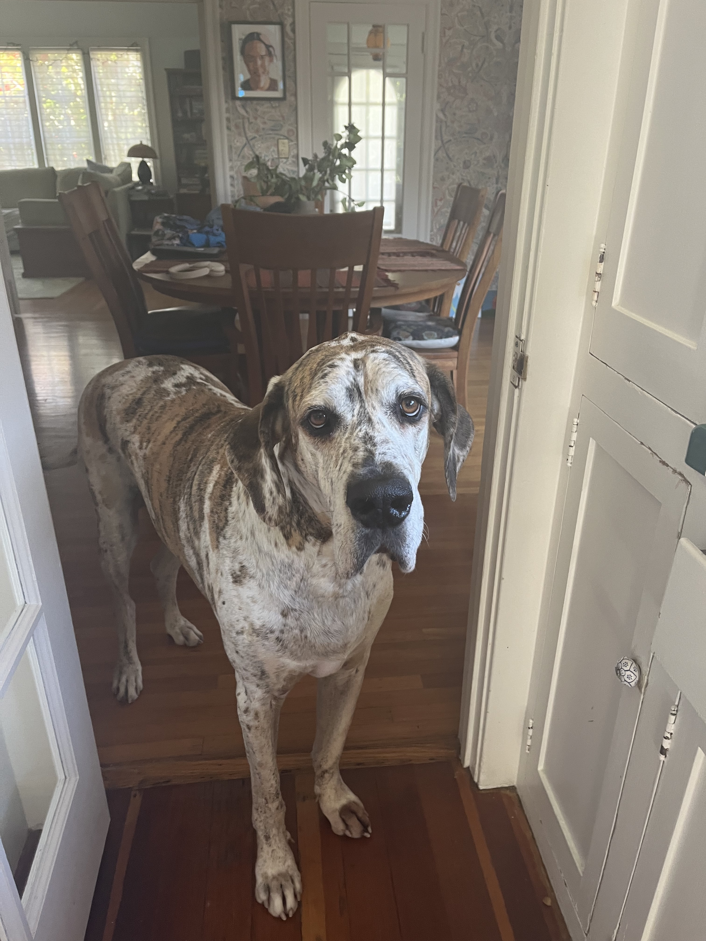
New DV Laws Webinar Erin Scott Family Violence Law Center escott@fvlc.org

Slide 5
AB 2123 – disability compensation, paid family leave Papan (d)
Eliminates the ability for employers to require employees to take two weeks of vacation leave before accessing Paid Family Leave benefits
Starts with periods of disability commencing January 1, 2025 or later
Paid Family Leave = time off to care for a seriously ill family member, bond with new child from birth, adoption or foster care placement
Notes:
Preserves purpose of vacation as distinct from intention of PFL. Also, employees have paid for PFL (that's how it's funded) so should be able to use it as soon as they are eligible.
PFL is part of the State Disability Insurance (SDI) program which is 100% worker funded.
Legal Aid at Work was the source of this bill.

Slide 6
AB 2499 – employment – unlawful discrimination and paid sick days for victims of violence Schiavo (d)
Expands the list of eligible crimes and allows employees to take time off to help family members who are victims of violence
Notes:
Applies to employers with 25+ employees
Changes “crime or abuse” to “qualifying act of violence” = domestic violence, sexual assault, stalking, or “an act, conduct, or pattern of conduct in which an individual causes bodily injury or death to another individual, in which an individual exhibits, draws, brandishes, or uses a firearm, or other dangerous weapon, with respect to another individual, or in which an individual uses, or makes a reasonably perceived or actual threat to use, force against another individual to cause physical injury or death.
Updates family member definition = child, parent, grandparent, grandchild, sibling, spouse, domestic partner or “designated person” which is “any individual not related by blood whose association with the employee is the equivalent of a family relationship”
Can use sick time
Employer can limit leave to 12 weeks total – sometimes 5 or 10 – see page 5
Legal Aid at Work, Californians for Safety and Justice, Crime Survivors for Safety and Justice

Slide 7
Sb 1090 – unemployment insurance – disability and paid family leave durazo (d)
Allows employees to apply for SDI or PFL up to 30 days before the first day they can be compensated and benefits must be provided within 14 days or as soon as eligibility begins
Notes:
Currently, employee has to wait to apply for benefits until they suffer a loss of wages. Then app is processed and when properly completed, EDD will pay benefits within 14 days. Delays common because of app errors or issues with doctor’s certification.
This bill gets the bureaucracy out of the way earlier...

Slide 8
Ab 799 – interagency council on homelessness Rivas (D), friedman (d), quirk-silva (d), ward (D), Wilson (d), et al
Adds the Governor’s Tribal Advisor to the council membership
Requires the council to develop and maintain a strategic funding guide and a calendar of new or existing funding opportunities
Requires increased coordination with state agencies and departments
Notes:
Increased coordination includes:
State grps provide council with updated funding opportunity information
Collect fiscal and outcome data from state agencies and make publicly available
Council’s purpose – oversee implementation of Housing First in CA:
- Create partnership among state agencies and departments
- Promote systems integration for efficiency and effectiveness
- Coordinate existing funding and competitive apps for funding
From the San Fernando Sun - https://sanfernandosun.com/2024/09/25/homelessness-funding-and-transparency-accountability-act-signed-into-law/
"The 2024 Auditor’s Report on Homelessness in California found that the state lacks information on its homeless programs’ costs and outcomes. It concluded that cities’ lack of established mechanisms to track and report spending “limits the transparency and accountability of the cities’ uses of funding to address homelessness.”
Under existing law, the California Interagency Council on Homelessness (Cal ICH) collects data regarding its efforts to prevent and end homelessness but is not required to report that data publicly.
AB 799 requires Cal ICH to implement more robust reporting requirements for fiscal and outcome data of state homelessness programs – tracking not only where the money is being spent, but also how effective the programs are in using that funding.
“By requiring stringent data tracking and reporting, the state will acquire a clearer picture of the effectiveness of the programs receiving funding to refine state strategies to reduce homelessness,” said Rivas.
She noted that Los Angeles has reported a reduction in homelessness for the first time – a “result of years of our work on making sure that the funding is going to effective programs that are actually reducing homelessness.”
The bill also requires that the information collected be reported publicly and adds tribal representation to the Council."

Slide 9
Sb 1051- lock changes for victims of abuse or violence eggman (d)
Expands housing protections for survivors so that lock change provisions mirror lease termination laws and eviction protections for survivors
Stops landlords from retaliating against survivors for exercising their rights under this bill
Notes:
Tenant’s (=victim or their immediate family member or household member is a victim) lock change written request – landlord must change no later than 24 hours after receipt at landlord’s expense (or reimburse the tenant if they paid)
Must include documentation – used to just be police report or court order, now mirrors other laws to include documentation from qualified third parties (DV, SA, HT, victim of violent crime advocate) or any other forms of documentation that reasonably verifies the violence re: violence against tenant, household member, or immediate family member
Adverse action prohibited if prospective tenant previously requested lock changes under this law or because they are a survivor (or prospective tenant's immediate family member or household member is a survivor)
California for Safety and Justice
Crime Survivors for Safety and Justice
FVAP
NCYL

Slide 10
Sb 1187 – tribal housing reconstitution and resiliency act mcguire (d)
Creates a new program solely to address tribal housing needs
Will manage the construction and rehabilitation of rental and owned housing
Notes:
Tribal communities have been excluded from benefitting from state-administered housing programs – this will help address accumulated disparities in tribal communities’ access to safe, affordable housing
Will live in the Department of Housing and Community Development
From McGuire's press release - https://sd02.senate.ca.gov/news/senate-leader-mcguires-historic-legislation-help-solve-californias-tribal-housing-crisis
"The program will also provide technical assistance to help tribal governments navigate the complex web of regulations that often hinder tribal housing projects.
Native American communities continue to face some of the most severe housing shortages in the state. Homelessness among Indigenous Californians is up to double that of the general population. One-third of Tribal residents live below the federal poverty line, more than twice that of the rest of California’s population. Approximately 9 percent of Tribes in California have homes that lack complete plumbing, and 7 percent lack complete kitchens, according to U.S. Census data.
More than a third of Native households live in overcrowded conditions, and nearly two of every five tribal member households are rent-overburdened, further exacerbating the housing affordability crisis, according to a study by the Rural Community Assistance Corporation and the California Coalition for Rural Housing.
Despite the clear need, the overwhelming majority of Tribes in California have been unable to access existing state affordable housing funds. Pre-existing funds are often too restrictive for tribes to meet the threshold and compliance requirements, and many of the requirements are mismatched compared to the needs that exist on Tribal land.
The Tribal Housing Act will address the severe housing shortage that exists on tribal lands by creating a new and separate housing program for tribal governments, taking a similar approach to the Joe Serna Jr. Farmworker Housing Grant Program, which is a designated fund that exclusively serves the housing needs of farm workers across the Golden State."

Slide 11
Sb 1415 – Calworks – permanent housing assistance glazer (d)
Changes the eligibility for CALWORKS eviction prevention payments
Notes:
Family’s total monthly income now will include amounts regularly received from other subsidy programs and private support – will increase the number of families who will be eligible under the “cannot pay more than 80% of their income toward rent” eligibility rule
*These amounts can’t count toward income for purposes of calculating cash aid
Starts 1/1/26

Slide 12
AB 2053 – pupil instruction about abusive relationships mathis (r), hoover (r), et al
Requires California Healthy Youth Act instruction to include 24/7 resources for students re: adolescent relationship abuse and IPV, including national and local DV hotlines

Slide 13
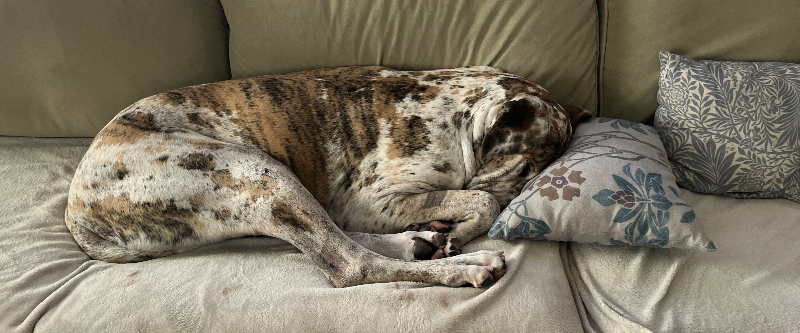
Happy New Year!
https://www.wickedmovie.com/gallery/
https://www.wickedmovie.com/gallery/
https://www.wickedmovie.com/gallery/

Slide 14
AB 1962 Crimes: Disorderly Conduct (“revenge porn”)
“Revenge porn”- intentionally distribute or cause to be distribute intimate images of another person
Punishable by up to one year in county jail
Elements:
Person distributing the image knows or should know the image will cause serious emotional distress
Person depicted actually suffers serious emotional distress
Person depicted + person distributing understood/agreed the images would remain private
#3 expands to include two additional scenarios:
Person who distributed the images recorded images without the other person’s consent and under circumstances in which the depicted person had a reasonable expectation of privacy OR
Person distributing the image stole the images from the person depicted

Slide 15
SB 1069: Office of the Inspector General
Grants the Office of the Inspector General investigatory authority over all staff misconduct cases that involve sexual misconduct with an incarcerated person
Full investigations of complaints unopened by CDCR (California Dept. of Corrections and Rehabilitation)
Supplemental investigation if IG determines existing CDCR investigation is inadequate
Background: In 2023, 130 formerly incarcerated women filed a lawsuit against CDCR and 30 correctional officers alleging sexual abuse while incarcerated. https://www.latimes.com/california/story/2024-01-18/every-womans-worst-nightmare-lawsuit-alleges-widespread-sexual-abuse-at-californias-womens-prisons

Slide 16
AB 2308: Post-conviction DV* criminal protective orders
In DV cases, post-conviction criminal protective order can be valid for up to 10 years, whether the person is sentenced to probation or state prison.
Length of post-conviction CPO is based on:
Seriousness of facts
Probability of future violations
Safety of victim and their immediate family
Expanded to 15 years for persons convicted of intimate partner abuse causing injury
Also authorizes termination or modification of CPO by written motion of prosecutor, defendant, or victim with 15 days’ notice to all parties.
Modification/termination requires good cause
For all other DV cases not involving abuse causing injury, the maximum duration of a post-conviction CPO is still 10 years

Slide 17
AB 2907 Firearms: restrained persons
Expands crime of firearms possession/ownership/purchase/receipt to individuals subject to CPOs issued in ALL domestic violence, elder abuse, and stalking cases
Enacts firearms relinquishment procedures for courts issuing CPOs in above cases (24 hrs. to relinquish, 48 hours to provide proof to the court)
Expands requirements for law enforcement and prosecutors in cases of firearms noncompliance

Slide 18
AB 2907 Firearms: restrained persons
Law Enforcement
Prosecutor
Court
In any dv crime:
Question arrestee, victim, and other household members about any firearms or ammunition owned or possessed by the arrestee
Query database (AFS) to find any firearms owned or possessed by arrestee and include copy when filing case
Ask arrestee, victim, and other household members about firearms owned/possessed by arrestee
Ensure firearm or other deadly weapon in plain sight or found during lawful search is taken into temporary custody
Document actions in detail in report
Upon receipt of court notice of violation: Take all actions necessary to obtain firearms/ammunition and address noncompliance as soon as practicable
Provide information gathered by law enforcement to the court for consideration in dv cases
2. Upon receipt of court notice of violation:
Take all actions necessary to obtain firearms/ammunition and address noncompliance as soon as practicable
1. Consider information provided by prosecutor when:
Setting bail or conditions of release
Considering plea agreement
Issuing CPO and determining the length of the CPO in dv, stalking, human trafficking, sex, and elder abuse crimes
2. Provide information to defendant on how to relinquish firearms/ammo and provide proof of compliance to court
3. Notify law enforcement and prosecuting agency within 2 business days of noncompliance finding

Slide 19
AB 2822: Law Enforcement Documentation
Requires law enforcement agencies to include in the incident report form a space for officers to document whether a firearm or deadly weapon was removed from the location of a domestic violence call.

Slide 20
SB 1394: Access to Connected Vehicles
Connected vehicle location access: allows person outside car to view/track car’s location, including through GPS
Connected vehicle service: allows person to obtain data from or send commands to a car remotely
July 1, 2025
Carmaker must provide clear process for driver to submit request terminating access to connected vehicle service and to create their own account
Driver must provide proof of legal possession (e.g., title, divorce, decree, DVRO awarding possession or exclusive use of the car to the driver).
Carmaker must terminate access within two business days of receipt of completed request
Jan 1, 2028/July 1, 2026 (depending on date of manufacture):
Manufacturer of vehicle with connected service shall clearly indicate to a person inside the car when a person outside the car has accessed either the connected vehicle service or connected vehicle location access
Cars with connected vehicle location access must include mechanism that allows driver to disable access from inside the car

Slide 21
AB 3138: License Plates
Jan 1, 2027
Allows personal vehicles to be equipped with digital license plates capable of GPS tracking
(Previously, only allowed for commercial and fleet vehicles)
Privacy protections required:
Technology can be manually disabled and enabled by driver while inside the car
Method of disabling/enabling shall be prominently located in the car and not require password/login info
Once disabled, can only be re-enabled manually from inside the car
Technology can be permanently disabled, stopping all location/tracking capabilities

Slide 22
SB 963: Hospital Self-Identification Procedures DV/HT Victims
All general acute care hospitals with an emergency department shall adopt and implement policies and procedures to facilitate the self-identification of an emergency department patient as a victim of human trafficking or domestic violence to hospital personnel. Minimum requirements:
Patient confidentiality
Safe and discreet means to inform hospital personnel that they are victim of DV or HT
Prompt, private, and VOLUNTARY interview of patient by medical personnel for purposes of providing information on services and resources
Information on local services/resources for HT/DV victims
Trauma-informed care
Grants immunity for hospitals for any injuries or damages arising from patient who self-identified as a DV or HT victim (including injuries inflicted by abuser based on acts/omissions taken by hospital IF acting in good faith)
Immunity does not apply to acts/omissions that are grossly negligent or constitute willful misconduct

Slide 23
SB 989: Domestic Violence Deaths (“Hidden Homicides”) Joanna’s Law
Joanna Hunter
October 27, 1974 – October 6, 2011

Slide 24
SB 989: Domestic Violence Deaths (“Hidden Homicides”)
Background:
2011 – Hunter found in Vacaville hanging from bathrobe belt in the master bedroom closet
Death closed as a suicide. Husband later arrested and convicted for attempting to firebomb girlfriend’s home
Suspicious factors in Joanna’s case
History of dv, including strangulation
She was trying to end relationship
Husband last to see her alive
Husband had access to her body
Crime scene appeared altered
Conclusion of Alliance for HOPE International: Joanna was murdered
Estimates of hidden homicides in U.S. range from 800—1200 per year (mostly women)

Slide 25
SB 989: Domestic Violence Deaths (“Hidden Homicides”)
1. Expands definition of legal representative authorized to obtain photos and recordings taken during autopsy for use in civil action to include family member of deceased (parent, sibling, child)
2. In cases of a deceased individual with an identifiable history of being victimized by domestic violence*:
- Prior to making findings as to manner and cause of death of deceased, LE must interview family members or close friends with information about dv history if 3 or more specified factors exist
-LE officers may request complete autopsy if any of the specified factors exist
-LE officers investigating death must be current in their dv training
-Family members shall have access to all victim services and support during investigation and review
-If LE makes finding that death is NOT a homicide and closes the case, family members/legal reps shall have right to request records of investigation
*domestic violence is defined in Family Code section 6211
*identifiable history = demonstrable past incidents that can be verified/corroborated

Slide 26
Suspicious Factors
Death occurred in premature or untimely manner
Crime scene indicates suicide or accident
One party wanted to end relationship
History of dv, including coercive control
Decedent found in home or place of residence
Decedent found by current or previous partner
History of dv, including strangulation or suffocation
Partner or child of partner/deceased was the last person to see decedent alive
Partner had control of the scene before arrival of law enforcement
Body moved or evidence/crime scene altered
Must also include these factors in statewide law enforcement guidelines on dv response under indicators of domestic homicide in suspicious death cases

Slide 27
New DV Laws: Foster care, restraining orders, firearms, judicial training, California Victims of Crime Act
Emberly Cross
Coordinating Attorney
Cooperative Restraining Order Clinic
San Francisco
emberly@roclinic.org

Slide 28
AB 2108 (Ramos) Foster care: missing children and non-minor dependents (the Luke Madrigal Act)
Mandates child welfare agencies and probation departments to provide immediate notice of missing child or non-minor dependent to family members, legal guardians, Indian custodians, attorneys, CASA, court, tribe or tribal representative, and local law enforcement agency (including tribal law enforcement agency for the child’s tribe)
28
Amends Welfare & Institutions Code §16501.35; specifically adds new subsections (2)(F) and (G) and subsection (3)
Notes:
Luke Madrigal – late Cahuilla Band of Indians elder and child welfare advocate. He served on his tribe’s council, and generously gave his time to the National Indian Child Welfare Association, Riverside County Tribal Alliance for American Indian Children and Families, and the American Indian Community Foundation.
As of October 1, 2023, there were 45,044 youth from birth up to 21 years of age in foster care in
California. (3/30/2024 Assembly Human Services leg analysis)

Slide 29
SB 554 (Cortese) Restraining orders
Petitioner for DV or Civil Harassment Restraining Order may file request in any county where jurisdiction is appropriate, even if petitioner is not a resident of California, including
county in which petitioner resides – or is temporarily located
county in which defendant/respondent resides
county in which the offense occurred
any other county with jurisdiction over the parties or subject matter of the case
Amends Code of Civil Procedure §527.6 to add subsection (a)(2) and Family Code §6301 to add new subsection (a)
29
Notes:
Sponsored by “Restraining Orders Without Borders”

Slide 30
AB 2024 (Pacheco) Domestic violence restraining orders
Prohibits court clerk from rejecting a DV restraining order request for filing as long as it
is submitted on mandatory Judicial Council forms
includes all of the forms required to issue an order
identifies the party submitting the request and the party to be restrained
30
Amends Family Code §6300 to create new subsection (c)

Slide 31
SB 899 (Skinner) Protective orders: firearms Amends, repeals, and adds multiple sections to CCP, Family Code, and Penal Code
Adds directive that peace officer shall upon request of a petitioner serve CHO, WVRO, SVRO, CPO, or Elder/Dependent Adult RO¹
whether or not respondent has been taken into custody
not only at the scene of violence or a violation
similar to directive that already exists for DVRO cases²
31
¹new Code of Civil Procedure §527.12
²existing Family Code §6383 – excludes parole officers and correctional officers

Slide 32
AB 3083 (Lackey) DV: protective orders: background checks
Augments requirements re checks for firearms prior to restraining order hearing
Court must check Department of Justice Automated Firearms System
If court has no access to DOJ AFS or CLETS, upon request of the court, the sheriff shall access CLETS to search the DOJ AFS and report results of search to court
States legislative intent that all courts conduct this search regardless of whether they have been identified as having resources available to do so
32
Amends Family Code §6306

Slide 33
SB 899 (Skinner) Protective orders: firearms Amends, repeals, and adds multiple sections to CCP, Family Code, and Penal Code
For CHOs¹, WVROs², SVROs³, CPOs⁴, Elder/Dependent Adult ROs⁵, and GVROs⁶, adds language already in DVROs⁷ for relinquishment of firearms and ammunition:
Court shall provide restrained party with information on how to relinquish firearms and ammunition and provide proof of doing so
Court shall review file for proof of relinquishment
Court shall report violations to prosecutor within 2 business days of the court hearing
If evidence of compliance is not provided, court shall order clerk to immediately – “by the most effective means available” – notify law enforcement
¹Code of Civil Procedure §527.6
²Code of Civil Procedure §527.8
³Code of Civil Procedure §527.85
⁴Penal Code §136.2
⁵Welfare & Institutions Code §15657.03
⁶Penal Code §18120
⁷Family Code §§6304, 6389(c)(4), 6306(f), added by 2021 legislation SB 320, effective January 1, 2022

Slide 34
SB 899 (Skinner) Protective orders: firearms Amends, repeals, and adds multiple sections to CCP, Family Code, and Penal Code
Creates process for firearms relinquishment review hearings in CHO, WVRO, SVRO, Elder/Dependent Adult RO¹, and GVRO²,cases, as already exists for DVRO cases³
¹new Code of Civil Procedure §527.11
²new Penal Code §18120.5
³existing Family Code §6322.5(c), added by 2021 legislation SB 320, effective January 1, 2022

Slide 35
SB 899 (Skinner) Protective orders: firearms Amends, repeals, and adds multiple sections to CCP, Family Code, and Penal Code
Modifies process for exemption from firearm relinquishment:
Sworn peace officer who is required to carry and cannot be transferred to non-carrying position, may be granted an exemption to carry specific firearm – on or off duty – if
officer’s personal safety depends on ability to carry outside work hours, and
officer does not pose additional threat of harm to protected party or public by having access to that firearm – including whether officer might use firearm for purpose other than as permitted
AFTER psych eval by licensed MH professional with DV expertise, which evaluation shall be considered by the court

Slide 36
SB 899 (Skinner) Protective orders: firearms and AB 2759 (Petrie-Norris) Protective orders: possession of firearm
Modifies process for exemption from firearm relinquishment:
NON-peace officer who is required to carry during work hours and cannot be transferred to non-carrying position, may be granted an exemption to carry specific firearm – during work hours – if
person does not pose additional threat of harm to protected party or public by having access to that firearm – including whether person might use firearm for purpose other than as permitted
Court may order psych eval by licensed MH professional with DV expertise

Slide 37
SB 899 (Skinner) Protective orders: firearms and AB 2759 (Petrie-Norris) Protective orders: possession of firearm
Modifies process for exemption from firearm relinquishment:
If exemption granted in TRO, court shall make finding whether exemption remains appropriate upon issuance of ROAH
If exemption granted in ROAH, court shall make finding whether exemption remains appropriate upon renewal of RO
Exemption may be terminated or modified if
respondent demonstrates need to modify specific firearm or ammunition,
respondent no longer meets requirements in this section, or
respondent violates the RO

Slide 38
SB 899 (Skinner) Protective orders: firearms Amends, repeals, and adds multiple sections to CCP, Family Code, and Penal Code
Court may grant “use immunity” for act of relinquishment

Slide 39
SB 899 (Skinner) Protective orders: firearms Amends, repeals, and adds multiple sections to CCP, Family Code, and Penal Code
Adds to grounds for search warrant under Penal Code §1524
When things to be seized include firearm or ammunition from restrained person who has been lawfully served with the restraining order¹ and has failed to relinquish
Adds to list of firearms to be entered by law enforcement into the DOJ Automated Firearms System those firearms required to be relinquished by CHO, WVRO, SVRO, CPO, Elder/Dependent Adult RO, DVRO, GVRO, or by any other section of law requiring such relinquishment
¹CHOs, WVROs, SVROs, CPOs, Elder/Dependent Adult ROs, and DVROs

Slide 40
SB 899 (Skinner) Protective orders: firearms Amends, repeals, and adds multiple sections to CCP, Family Code, and Penal Code
Creates procedures for transfer or disposal when firearms dealer cannot legally return to owner firearms or ammunition that were stored with dealer during relinquishment period

Slide 41
AB 3072 (Petrie-Norris) Child custody: ex parte orders
In considering immediate harm to the child in request for ex parte order, court shall consider
parent’s illegal access to firearms and ammunition, including whether parent is prohibited from having them
If court makes ex parte order re custody, court shall
consider whether visitation should be suspended, denied, or supervised, and
consider the nature of the acts that led to the finding of risk of immediate harm
Amends Family Code §§3064 and 3100

Slide 42
SB 899 (Skinner) Protective orders: firearms Amends, repeals, and adds multiple sections to CCP, Family Code, and Penal Code
Adds to rebuttal factors for Family Code §3044 whether parent is restrained person in possession of firearm or ammunition in violation of CHO, WVRO, SVRO, CPO, or
Elder/Dependent Adult RO
(Possession of firearm or ammunition in violation of DVRO was already in Family Code §3044)

Slide 43
AB 1974 (Petrie-Norris) Family courts: evaluator training
Adds to training requirements for evaluators “The risks associated with access to firearms and ways to reduce those risks.”
Amends Family Code §1816 by adding subsection (d)(5)(L)

Slide 44
SB 1356 (Wahab) Judiciary: training: gender bias
In developing training on gender bias for judges,
the Judicial Council shall consider the role of gender in court proceedings, including strategies to counter stereotypes, taking into account inequities in power and their intersection with gender, and meeting the needs of litigants in unique situations of vulnerability
Amends Government Code §68088

Slide 45
AB 2432 (Gabriel) California Victims of Crime Act
Establishes new California Crime Victims Fund
from white collar crime fines and fees
to fund victims’ services programs
Amends Penal Code §1202.4, adds Penal Code §1398, and adds new Article 5, Penal Code §13839

