Slide 1
Prevention Peer Network February 23, 2017
Notes:
Start recording

Slide 2
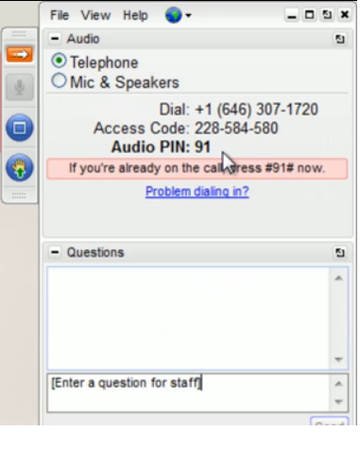
Control Panel
Expand Audio for call in information
Expand/minimize the control panel
Raise your hand to be unmuted
Type questions/comments here
Please note, this webinar is being recorded.

Slide 3
Agenda
Opening Circle
Primary prevention trainings offered through the Partnership
Q&A
Discussion: Shared expertise, emerging issues, challenges, triumphs
Notes:
These webinars are open to anyone.

Slide 4
Opening Circle
Please type in your name, agency and location

Slide 5
Prevention Trainings: Strategic Communications to Prevent Adolescent Dating Abuse

Slide 6
Training Locations
Previous Trainings:
January 2016 – Sacramento
November 2016 –Irvine
November 2016 – Red Bluff
January 2017 – Sacramento
Upcoming Trainings:
March 28th – Santa Clara
April 4th - Fresno

Slide 7
Current Framing
How often is teen dating violence discussed in the media?
When is teen dating violence covered in the media?
How can we stop teen dating violence?

Slide 8
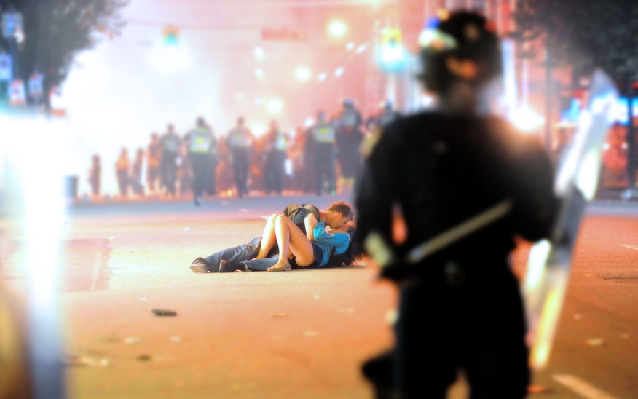
Framing
Portrait vs. Landscape
Individual vs. Community
Reframing

Slide 9
Identify Policy Goals and Messages
What are your current policy and prevention goals?
What messages and messengers can help you accomplish these goals?
Who’s influence is needed to pass or adopt your policy goals?

Slide 10
Message Themes
What’s wrong?
Concern
Why does it matter?
Value
What should be done?
Solution

Slide 11
Message Themes
Examples of messaging themes to use throughout our work.
Students can’t learn if they’re hurting or don’t feel safe.
Schools have a responsibility to give students the skills they need to succeed in the classroom and in life.
Healthy relationships are the foundation for a strong and healthy community.
Together we can prevent teen dating violence.
Notes:
Registration link in follow up email.

Slide 12
Follow Up Webinar Series
Effectively Engaging School Boards
Community Engagement and Coalition Building
Steps To Create Positive Media Coverage Part 1
Steps To Create Positive Media Coverage Part 2
Using Social Media to Change the Narrative

Slide 13
Questions
?
Notes:
Registration link in follow up email.

Slide 14
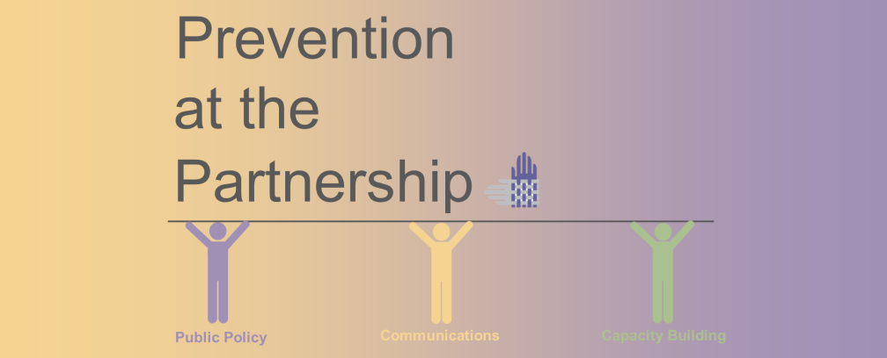
Upcoming Trainings
Strategic Communications Training to Prevent Adolescent Dating Abuse
Tuesday, March 28, 2017 – Santa Clara, CA
Tuesday, April 4, 2017 – Fresno, CA
Registration is now open
Notes:
These webinars are open to anyone.

Slide 15
Contact Us
Contact Micah to register or get more information about the upcoming trainings
Micah Zimmermaker Prevention and Education Policy Specialist California Partnership to End Domestic Violence
micah@cpedv.org
(707) 367-2187
Notes:
Registration link in follow up email.

Slide 16
Prevention Trainings: Building Change Together Primary Prevention Core Competencies

Slide 17
Collaborative Effort

Slide 18
Core Competencies
Foundations in Primary Prevention of DV/TDV/SV and Social Change
Planning
Implementing
Evaluating
Sustaining

Slide 19
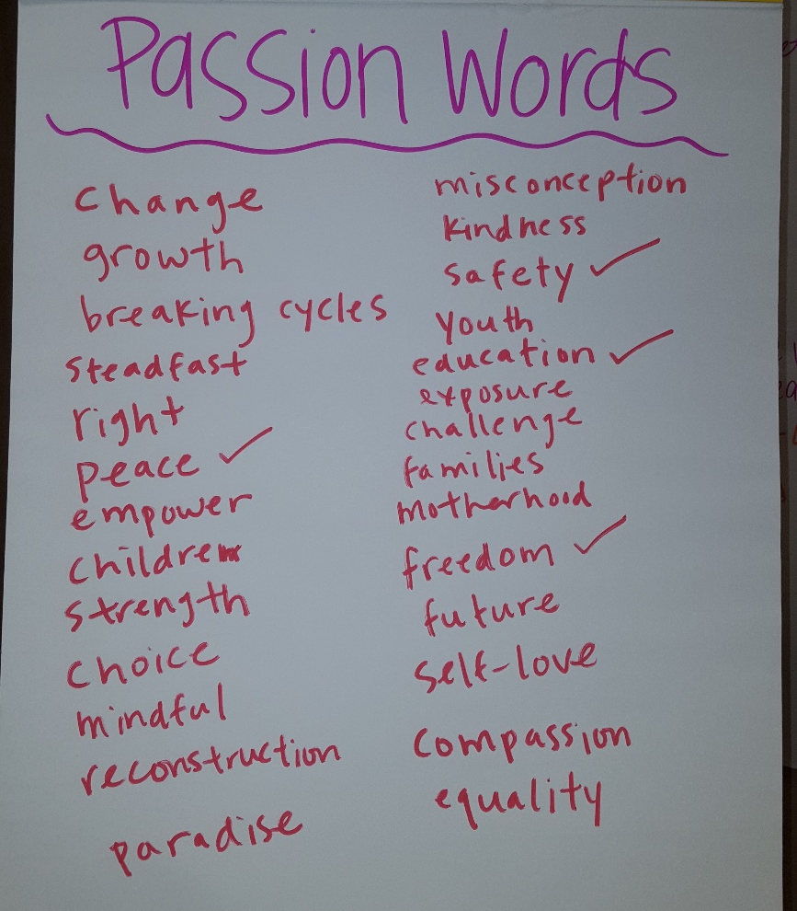
Community of Practice
Prevention practitioners can feel isolated
Prevention efforts can feel siloed within organizations and/or communities
Collaborative and supportive Community of Practice among prevention advocates

Slide 20
Social Justice Approach to Violence Prevention
Intersecting forms of oppression and their links to prevention of DV, TDV, and SV
Intergenerational and community initiatives
Engaging multilingual communities

Slide 21
Youth Collaboration
Explore adultism
Promote youth development and intergenerational partnerships
Evaluate youth engagement within organizations

Slide 22
How has this been implemented?

Slide 23
Youth Collaboration

Slide 24
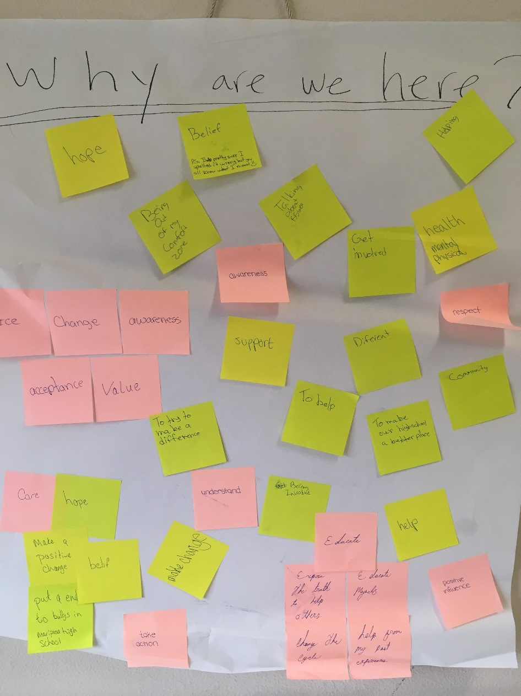
Youth Collaboration

Slide 25
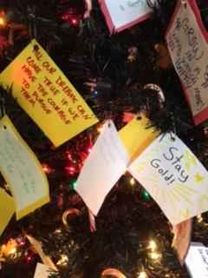
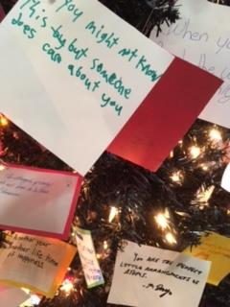
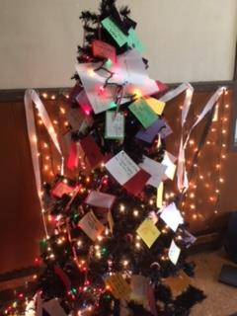
Youth Collaboration

Slide 26
Youth Collaboration

Slide 27
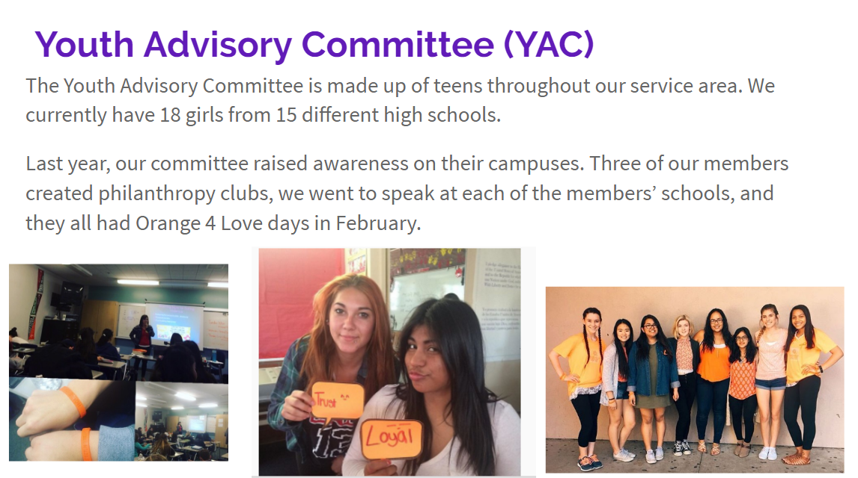
Youth Collaboration

Slide 28
Youth Collaboration

Slide 29
Youth Collaboration

Slide 30
Youth Collaboration

Slide 31
Collaborative Change Approach
Apply the Collaborative Change Approach
Provides structure
Develop a shared set of goals and values
Community Change
Engaging Resistance

Slide 32
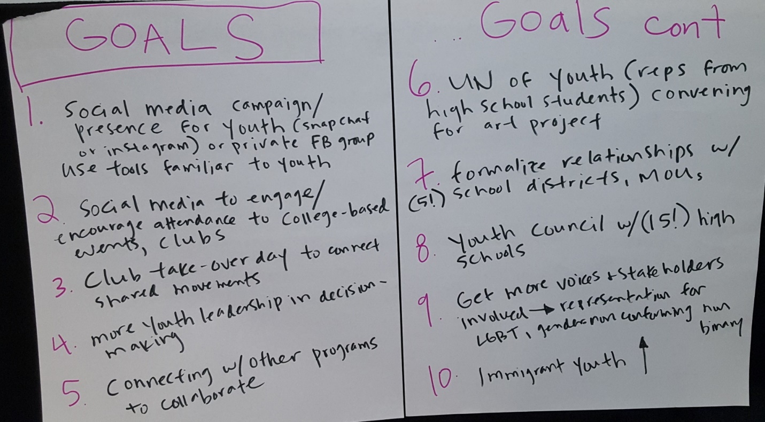
Action Plans
Provide space for practitioners to apply learnings and develop Action Plans
Identify needs for ongoing training and support

Slide 33
Questions
?
Notes:
Registration link in follow up email.

Slide 34
Shared expertise and discussion
Challenges or triumphs?
Emerging issues?

Slide 35
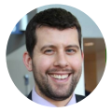
Together we’re stronger
Micah Zimmermaker
Prevention and Education Policy Specialist
micah@cpedv.org
Miranda Stiers
Capacity-Building Program Coordinator
miranda@cpedv.org

